Slide 1
Lecture 13
Cities in History; Urban Precursors: Hunter-Gatherer Camps and Densification
13.2 Urban Precursors: Hunter-Gatherer Camps and Densification
IUS 7.2
©Luís M. A. Bettencourt 2024
Notes:
How far back can we push these ideas? We should be able to push them all the way to the beginning of urbanism ! The advent of cities must have been a “phase transition” in social life, but how can we find this transition and characterize it carefully? Here we will look at people who are hunter gatherers, who have settlements but these are typically temporary, are these photo-cities? This way of life persisted for may tens of thousands of years for early humans.

Slide 2
Anthropology
Early and Small Scale Societies
Notes:
Let’s just take a step back and understand the perspective of people studying these societies … most are anthropologists …

Slide 3
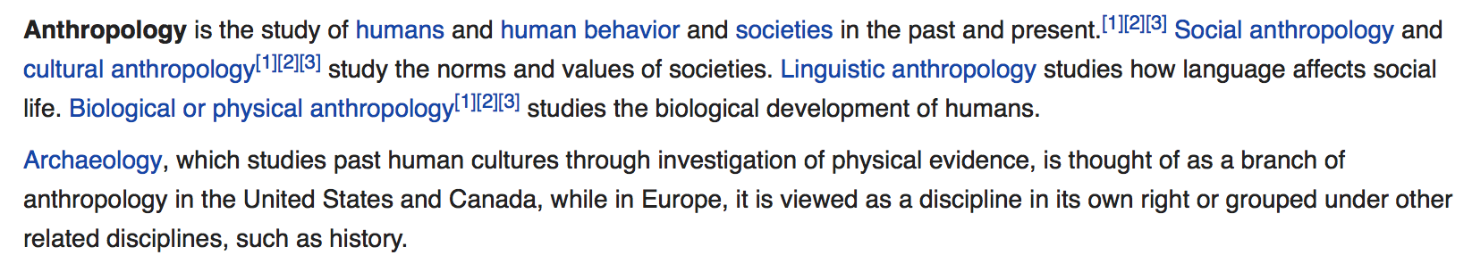
Anthropology is the study of human cultures
Notes:
Anthropology is many things, but here it is the study of culture and its evolution in small societies…

Slide 4
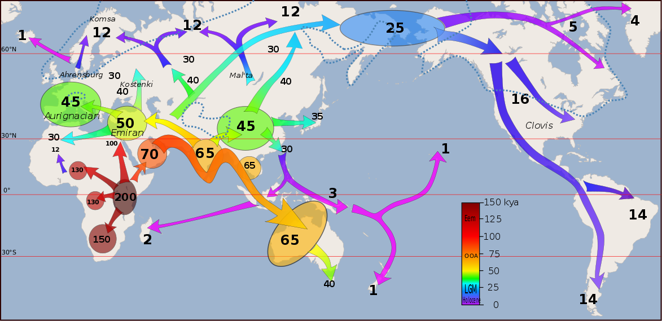
A very successful species
a subsistence way of life
Humans’ early expansion throughout the world
credit: wikipedia, Metspalu et al
Notes:
Humans lived as Hunter gatherers for a long time. It is a very successful way of life that allowed our ancestors to spread throughout the planet and adopt locally appropriate ways of life, technologies and so on. Why change?

Slide 5
Early cultures were
Hunter Gatherers
“foragers”
mobile
sedentary
“The archaeological record shows that the mobile hunting and gathering way of life is also remarkably stable, exhibiting slow rates of material and technological change in comparison with more settled and denser societies.”
https://www.cambridge.org/core/books/lifeways-of-huntergatherers/119FA31DAC04B7A4787D1C6B0248AFEE
Notes:
Ok, now everyone lives somewhere. And socialization beyond the family needs some place. HGs are classified mostly as mobile, if they have no permanent settlements (just temporary camps) and sedentary, for those who live permanently around a rich resource… this is rarer.

Slide 6
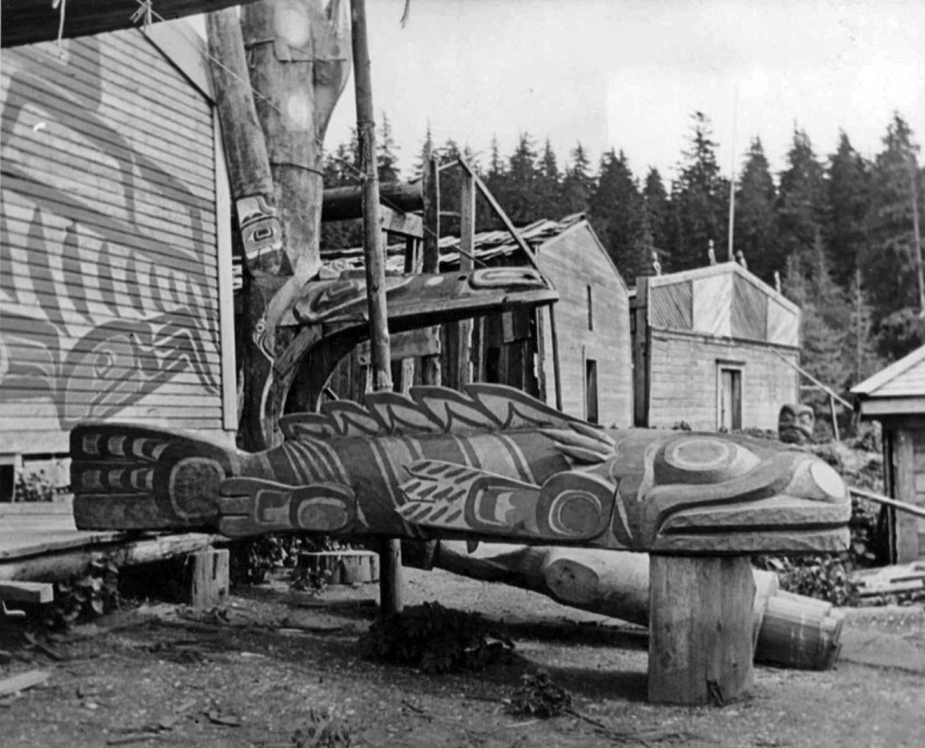
Gwayasdums / Gwaestums (Gilford Island)
credit: George MacDonald
Notes:
But happens for example in the Pacific Northwest: these people have what looks like villages, with houses, monuments and so on as you can see…

Slide 7
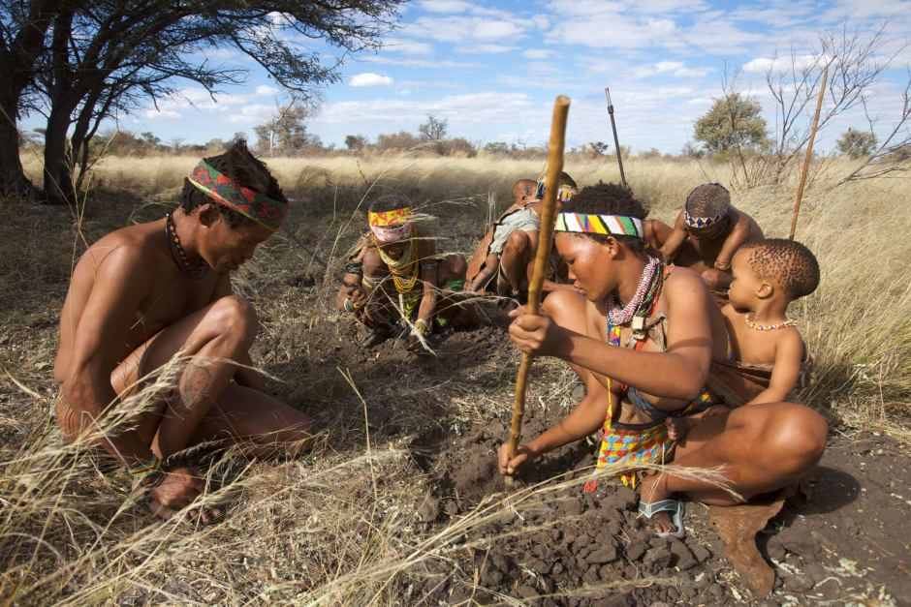
!Kung San
credit: Getty images
Notes:
These are maybe more typical mobile HGs from a different part of the world. They live most of the time in family units but sometimes get together and for larger camps.

Slide 8
Mobile Hunter-Gatherers
Not enough food density to support large groups in one place
Egalitarianism: Socially sanctioned limits on privacy and private property
Limited conflict resolution
No elaborate construction, walls, limited food storage
Characteristic Social Patterns of Fission and Fusion in Space-Time
foraging single-family units
larger social “camps”
Notes:
Mobile HGs are made to move because there is typically not enough food density throughout the year to sustain them. But they also have culture that enforces the sharing of resources (like from hunting), and that typically requires handling conflict simply by walking away. Thus, larger camps are always subjected to limitations following from the availability of energy and from conflict.

Slide 9
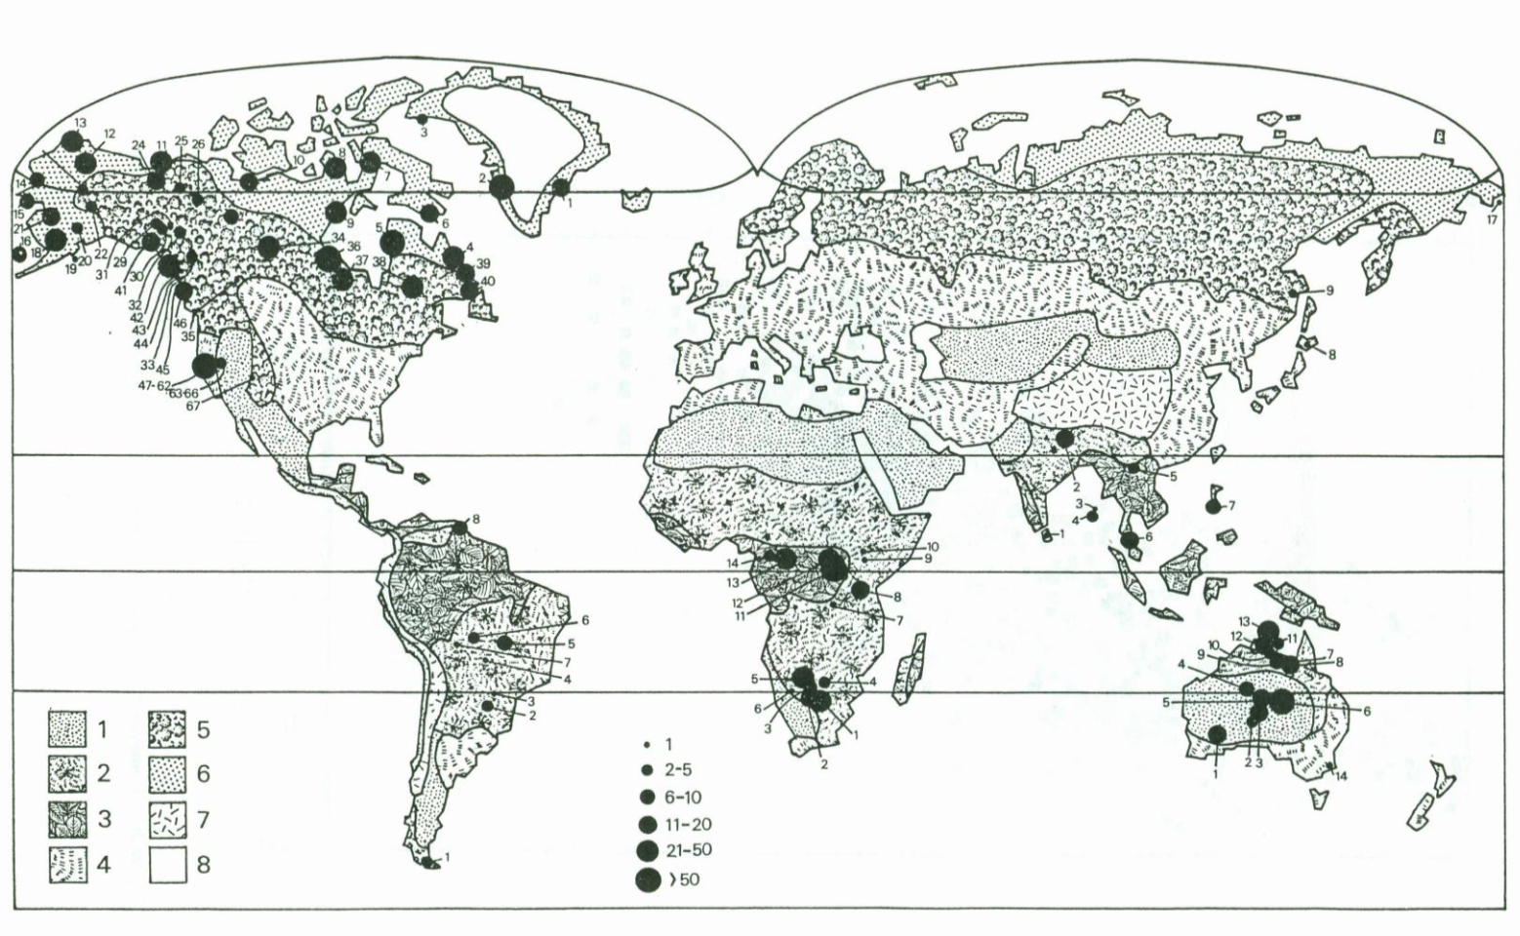
Large worldwide survey of Hunter-Gatherer Camps
credit: T. Whitelaw 1989
https://www.repository.cam.ac.uk/handle/1810/272725
Notes:
Whitelaw assembled a dataset of HG camps … it spans many different geographies and cultures …

Slide 10
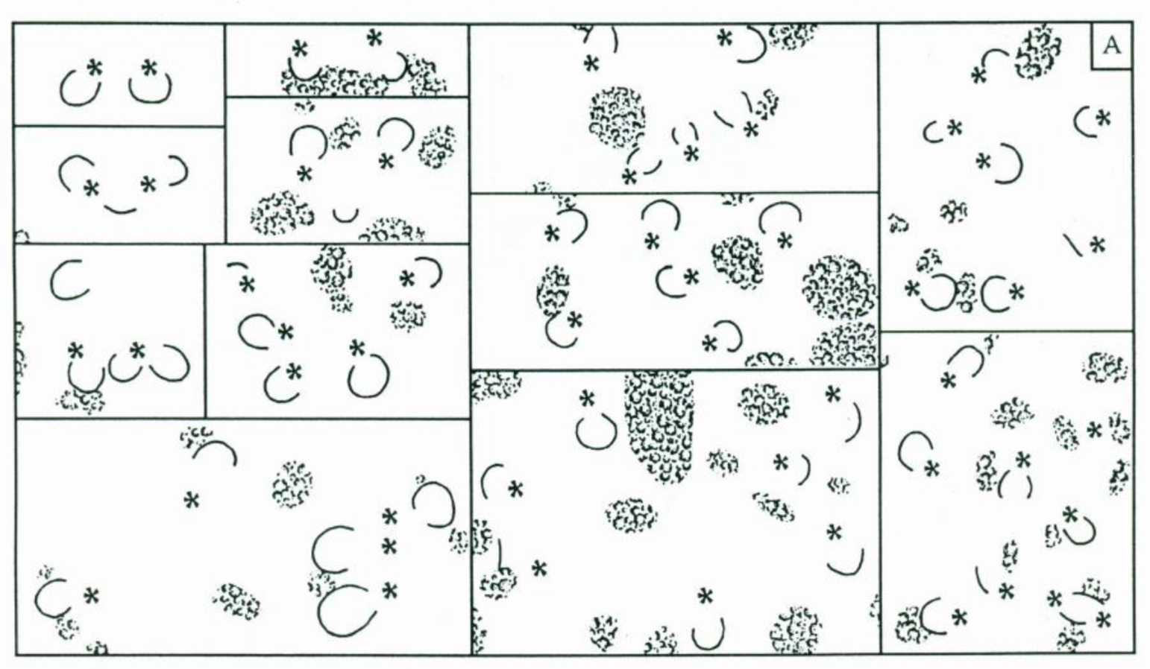
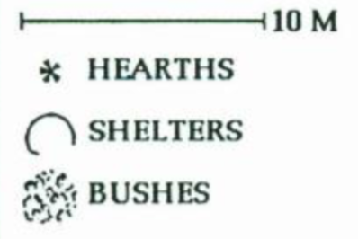
Small “Extended Family” camps
credit: T. Whitelaw
https://www.repository.cam.ac.uk/handle/1810/272725
Notes:
Here are a few (very pretty) camps, each family typically has a hearth with a fire etc and then several families camp nearby…

Slide 11
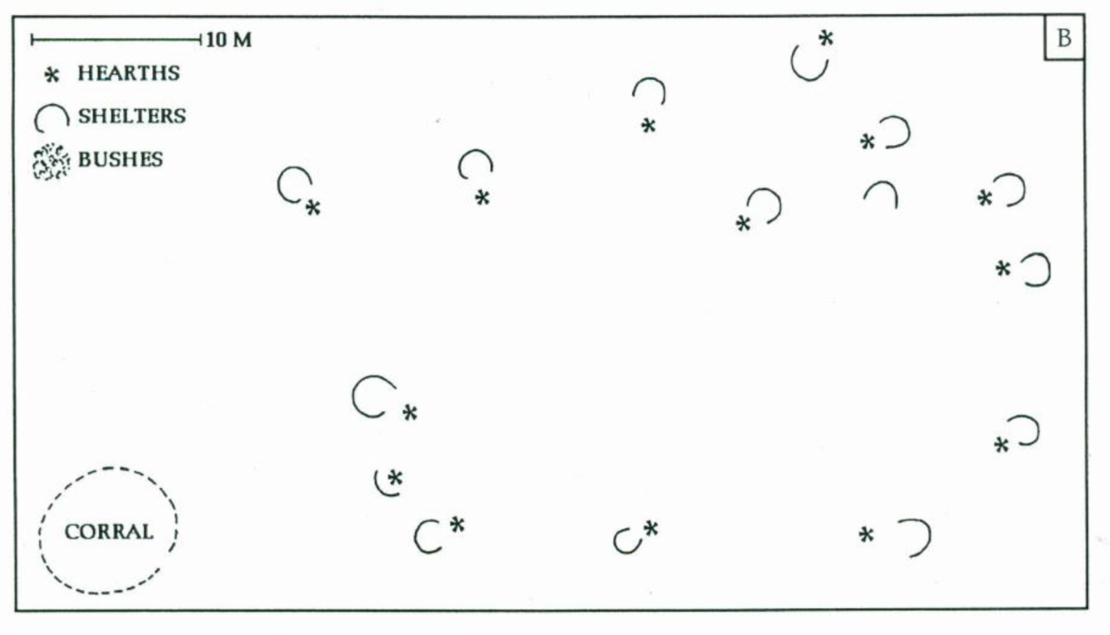
Large rainy-season camp
Like in Western movies
ring model
credit: T. Whitelaw
https://www.repository.cam.ac.uk/handle/1810/272725
Notes:
Here’s a larger one. Because of the quasi-circular arrangement, several authors proposed a “ring model” to describe the population vs area of these camps.

Slide 12
Ring Model for H/G Camps
families camp along the perimeter of a common area
area
$$A=\frac{a^{2}}{4π}N^{2}$$
$$A=πR^{2}$$
circle
$$P=aN→R=\frac{a}{2π}N$$
$$P=2πR$$
perimeter
Area is superlinear on Population !!!
P Wiessner 1974
https://www.cambridge.org/core/journals/american-antiquity/article/abs/functional-estimator-of-population-from-floor-area/5345979420D340EEA82F3AF53D2743F2
Notes:
So let’s do the math for the ring model (Wiessner): the perimeter is proportional to the number of families (population) so you get …. A superlinear relation (exponent = 2) for the population vs area !! This is the opposite of the densifying effect of cities (including ancient cities! These people are doing something different.

Slide 13
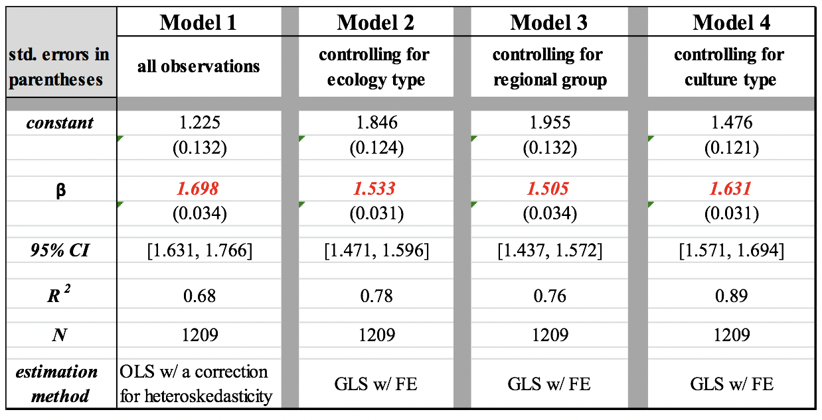
Area - Population relationship of H/G camps
$$A(N)=A_{0}N^{β}$$
forgive notation of exponents not consistent
Superlinear !?
Lobo et al 2018
https://www.journals.uchicago.edu/doi/abs/10.1086/719234
Notes:
OK, is this general? When we do a lot of scaling fits we find exponents that are superlinear ! But the values are more like 1.5 or so and a bit variable …

Slide 14
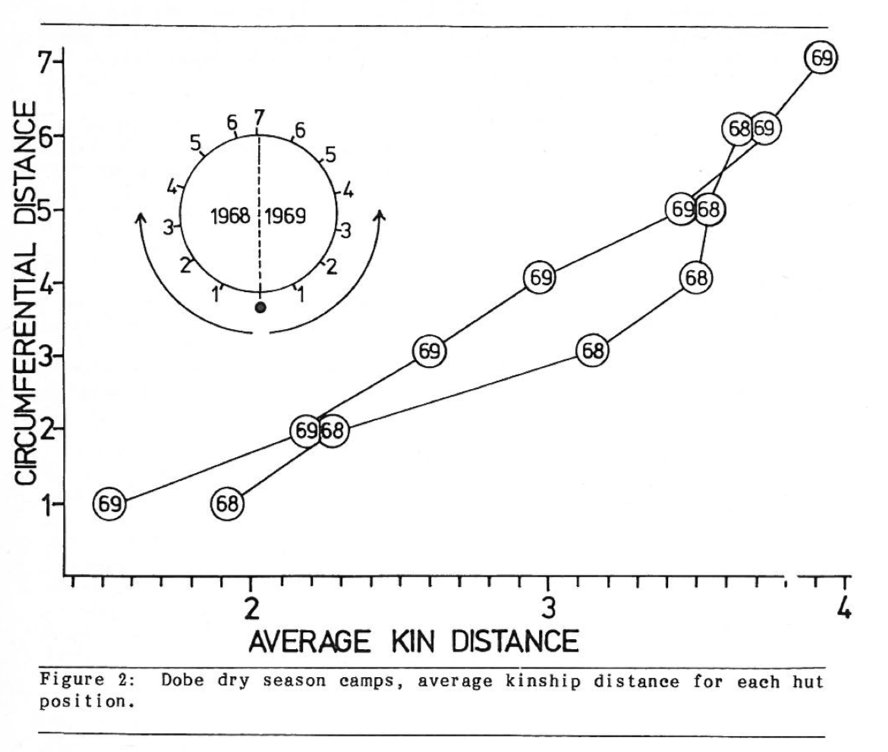
credit: T. Whitelaw
Notes:
What is the explanation for this sort of numbers? Well, in order to get there we need a bit more information about what people are actually doing. One of the things is that they camp closer to closer relatives and put more distance between less related people, as you can see here …

Slide 15
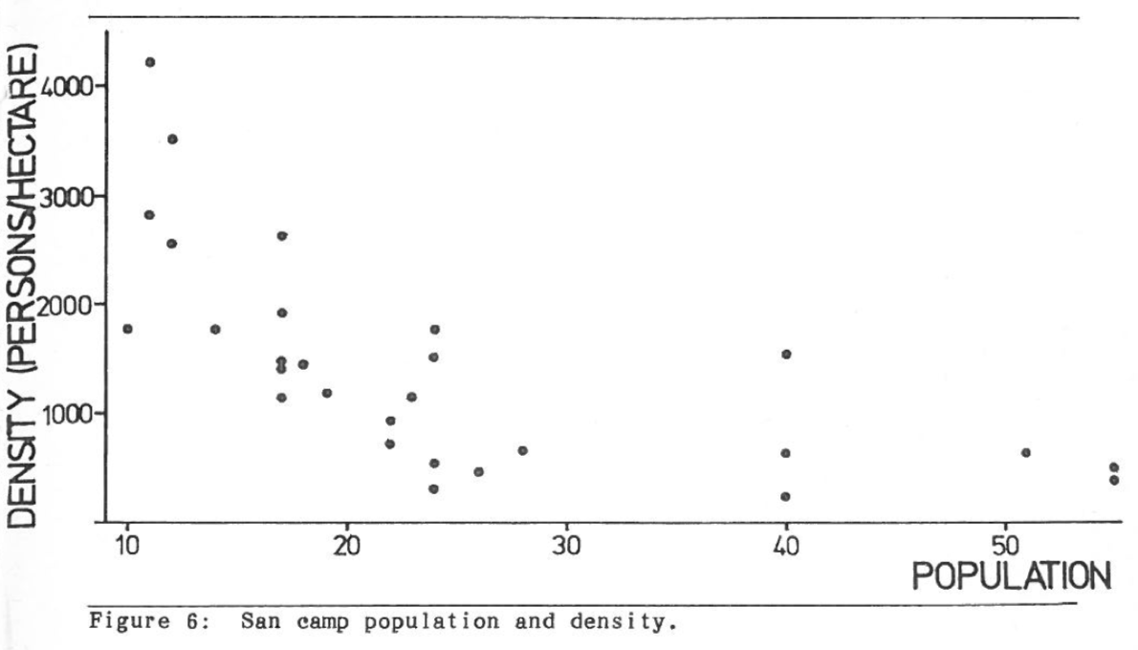
superlinear
Density decreases !
$$A=\frac{a^{2}}{4π}N^{2}$$
$$n=\frac{N}{A}=\frac{4π}{a^{2}}\frac{1}{N}$$
camp area
population density
credit: T. Whitelaw
Notes:
The fact that the density of camps is lower for larger (more people) camps is also weird from the perspective of cities, but makes sense from the perspective of scaling in the Ring model (or other superlinear relations).

Slide 16
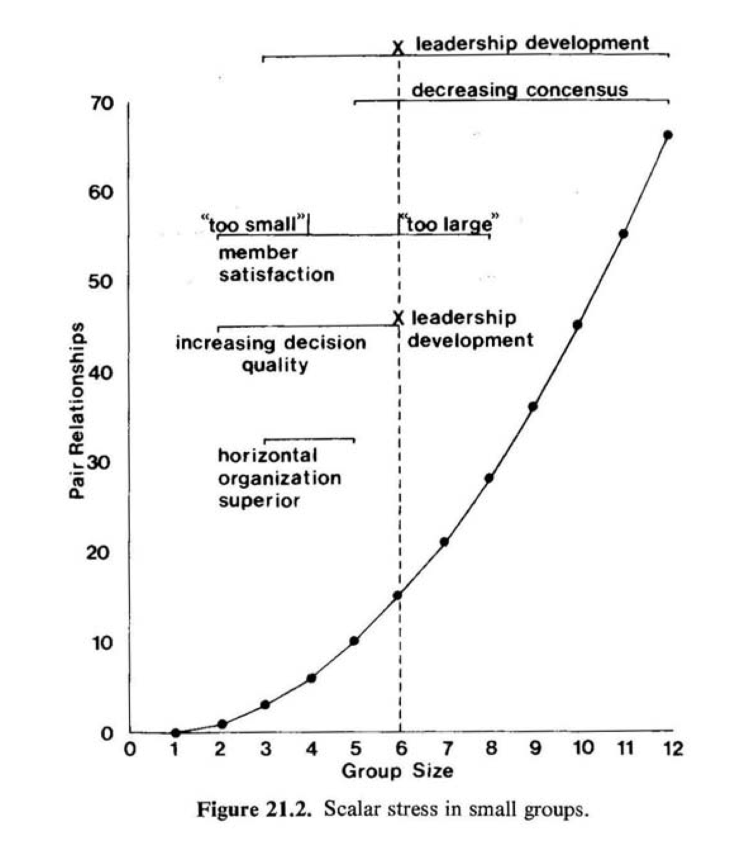
Scalar Stress
a network theory of conflict
Like Metcalfe’s law, but for conflict
credit: Johnson 1982
https://wiki.santafe.edu/images/3/3b/Johnson1984scalarstress.pdf
Notes:
A concept that has concerned anthropological studies is so called “scalar stress” where conflict increases super linearly with group size. This is an example of a negative superlinear effect.

Slide 17
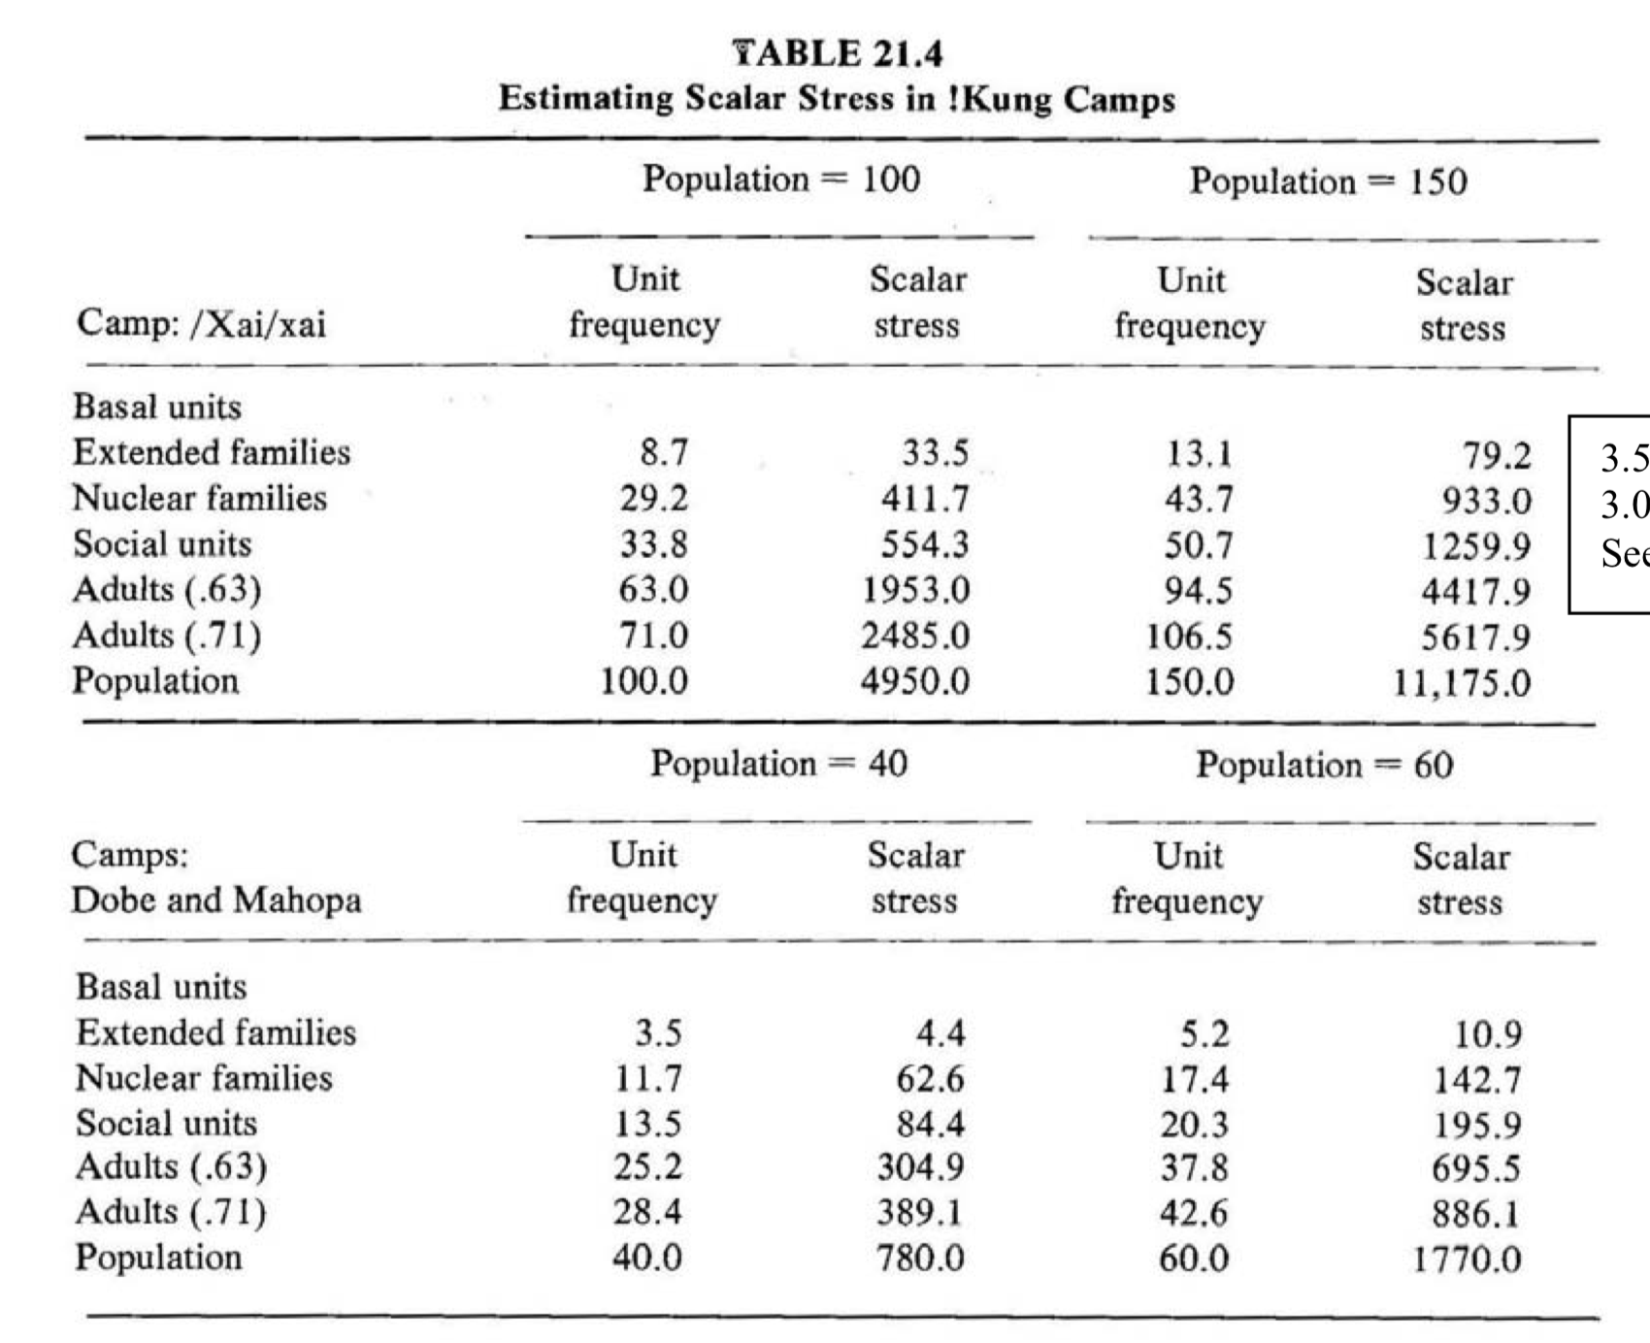
credit: Johnson 1982
Like Metcalfe’s law, but for conflict
stress increases with camp size
“The primary results of this analysis are that first, the number of extended families is the best (and quite accurate) predictor of relative dispute frequency.”
https://wiki.santafe.edu/images/3/3b/Johnson1984scalarstress.pdf
Notes:
This is just a table view from the original paper of what the concept of scalar stress is…

Slide 18
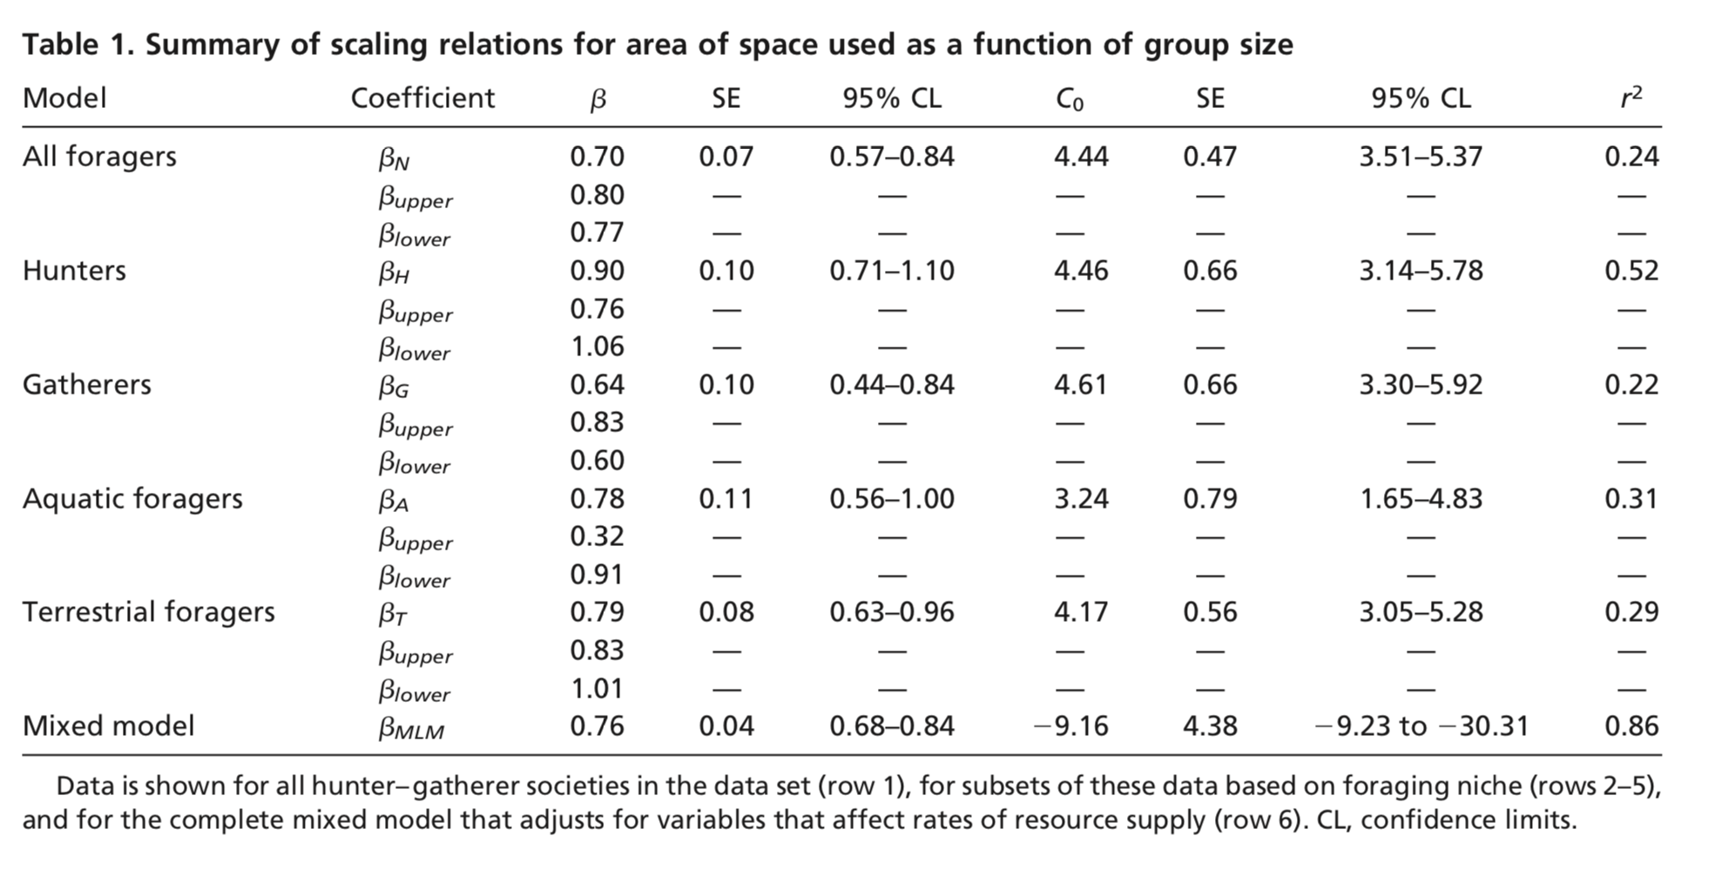
But, meanwhile, on larger scales
Total Foraging Areas are sublinear
$$A_{f}=aN^{β}$$
Density is usually scale dependent
For Hunter-Gatherer’s it is increases at large scales
Hamilton et al 2007
https://www.pnas.org/doi/10.1073/pnas.0611197104
Notes:
Ok, one last ingredient. Interestingly on larger scales of entire foraging territories, other authors have found that the area population relation is sublinear and exponents are of order 2/3… So some signatures of the advantages of sociality can be there starting with low densities, but are (eventually, over the long term) overcome by disadvantages on small scales. This paints an interesting picture where some of the network effects are there, but not at high densities. The city forms from the outside in, perhaps.

Slide 19
Better Model
advantages of socialization+scalar stress+kin-structure+energy
Biology
tension
Society
Obtain energy:
Create culture:
$$\frac{dE}{dt}=r_{E}=r_{0}-k\frac{N-1}{A},\frac{dS}{dt}=r_{S}=G\frac{N-1}{A}-r_{C}$$
costs per unit time: scalar + movement
Logistic Dynamics:
Population density
$$r_{E}=k\left(n_{E}-\frac{N}{A}\right),r_{S}=G\left(\frac{N}{A}-n_{S}\right).$$
critical density for energy
critical density for socialization
wants low density
$$n_{E}=\frac{r_{0}}{k},n_{S}=r_{C}G$$
wants high density
Lobo et al 2018
https://www.journals.uchicago.edu/doi/abs/10.1086/719234
Notes:
We now show how to model this situation. We want to take into account the dynamics of both energy and “information” I.e. the cultural products of social interactions that a society can accumulate when in close and continuing interaction. The idea is that there is a tradeoff, at low densities one has sufficient food but not culture, while at high densities one could have enough culture but not enough food? What is the solution towards having both?

Slide 20
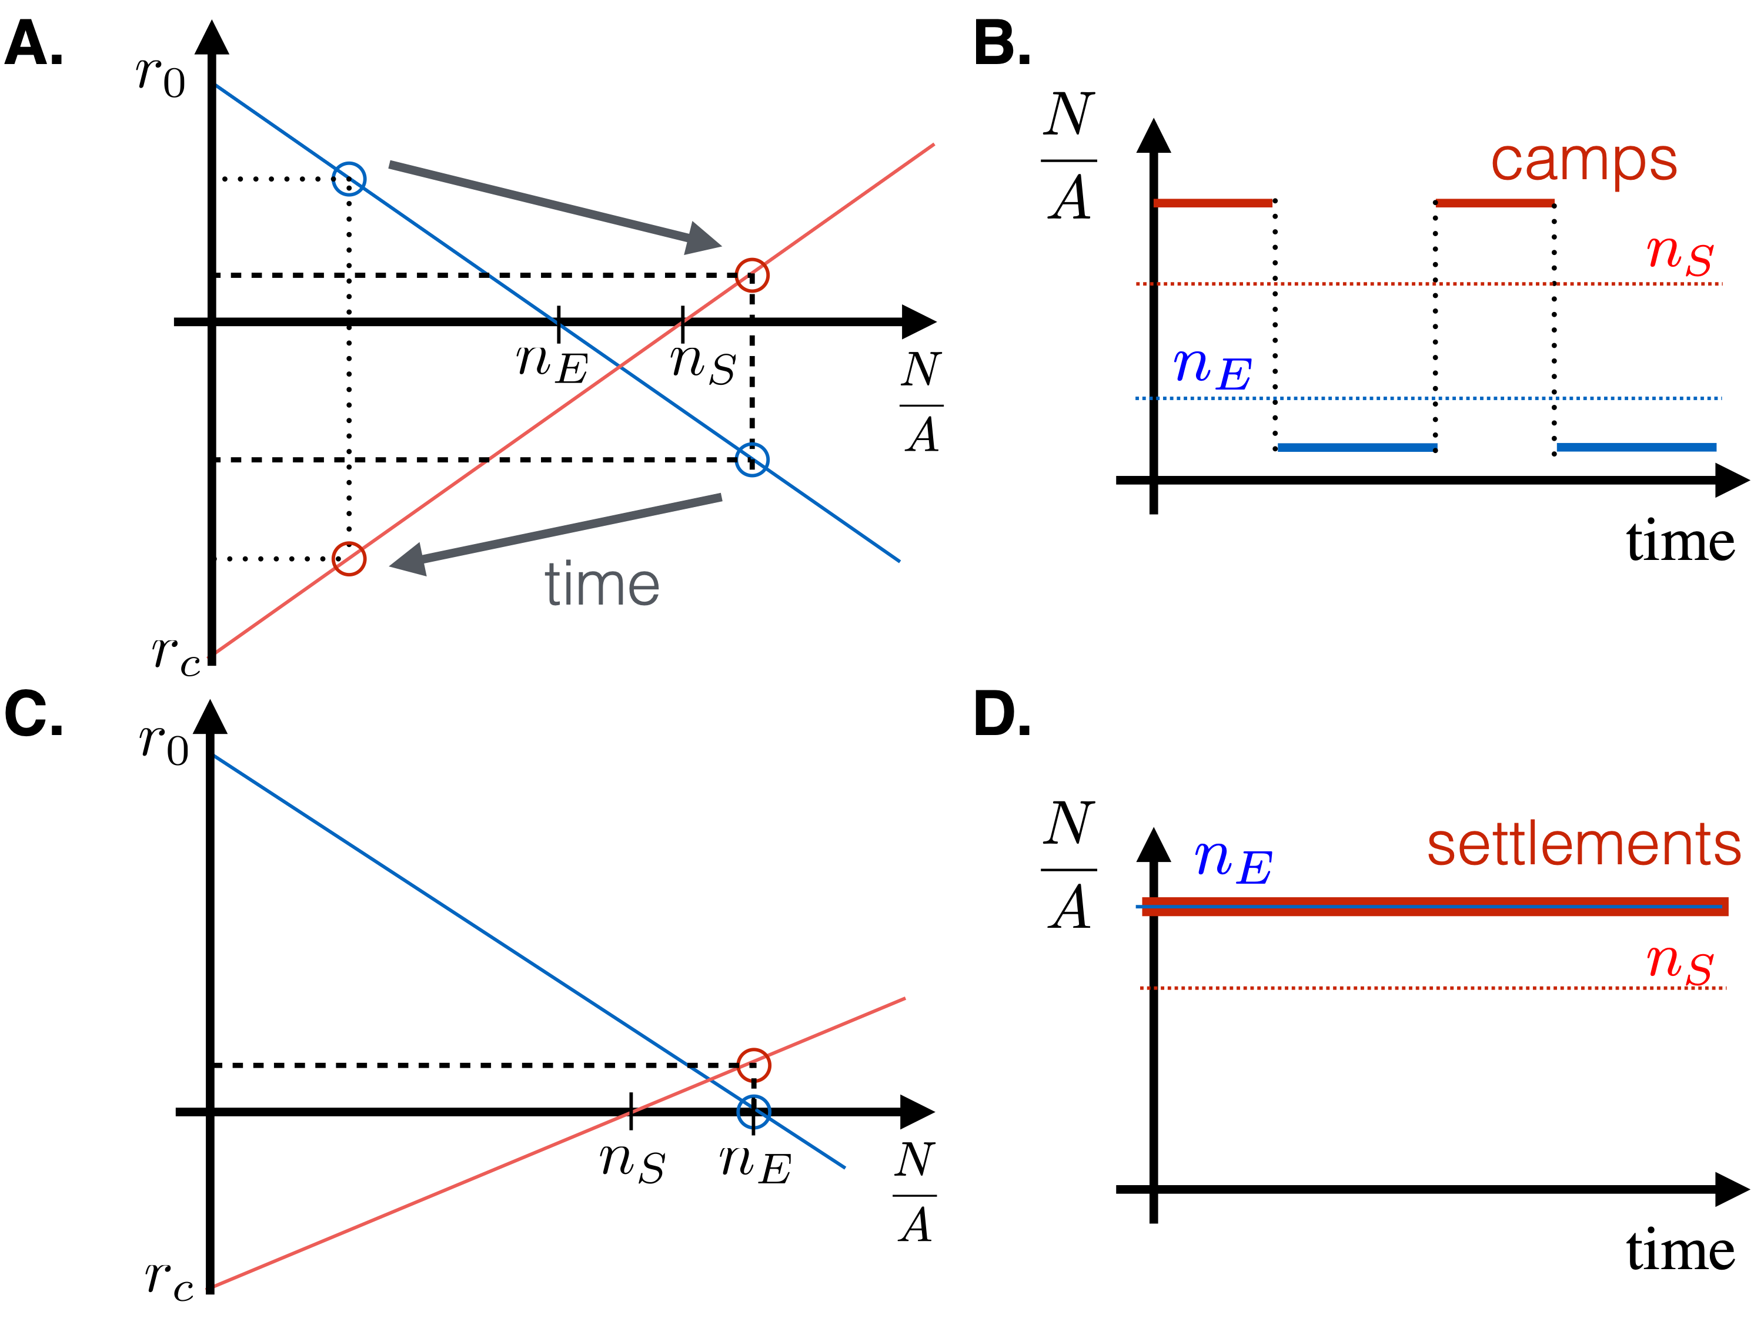
energy poor, stressful
Cities are impossible
fission/fusion
energy rich, peaceful
Cities become possible
permanent settlements
Lobo et al 2018
https://www.journals.uchicago.edu/doi/abs/10.1086/719234
Notes:
This shows schematically the equations from the previous page and when both quantities grow or decrease. For energy to be sufficient, the population density has to be smaller than n_E and for culture accumulation larger than n_S: when n_S < N_E then a population can stay put, but otherwise, it needs to oscillate between low density periods where it gathers energy, and high density periods when it uses that energy (but enters a negative flow) and accumulates culture. The conjecture is that this is the case with mobile hunter gatherers, except if they hit a very rich resource (like Salmon in the Pacific NW).

Slide 21
Simple model for costs of socialization
$$r_{C}(R)=ϵR+ρ\frac{ℓ(N)}{R}.$$
movement
leads to:
scalar stress
$$G\frac{N}{R^{2}}=ϵR+ρ\frac{ℓ}{R}→R^{3}+R_{*}^{2}R-\frac{G}{ϵ}N=0$$
$$R_{*}=\sqrt{\frac{ρℓ}{ϵ}}$$
$$R≪R_{*}:R≃\frac{G}{ϵR_{*}^{2}}N→A(N)=A_{0}N^{2}$$
Camps
$$R≫R_{*}:R^{3}≃\frac{G}{ϵ}N→A(N)=A_{0}N^{2/3}$$
Foraging territories
Lobo et al 2018
https://www.journals.uchicago.edu/doi/abs/10.1086/719234
Notes:
We can say a bit more, that costs of socialization should be density dependent, and increase substantially at low distances (R) due to conflict. If this is the case then there can be two regimes, one at high densities leading to superlinear area-population relationship in camps, and another at low densities leading to a sublinear relationship in the total foraging area.

Slide 22
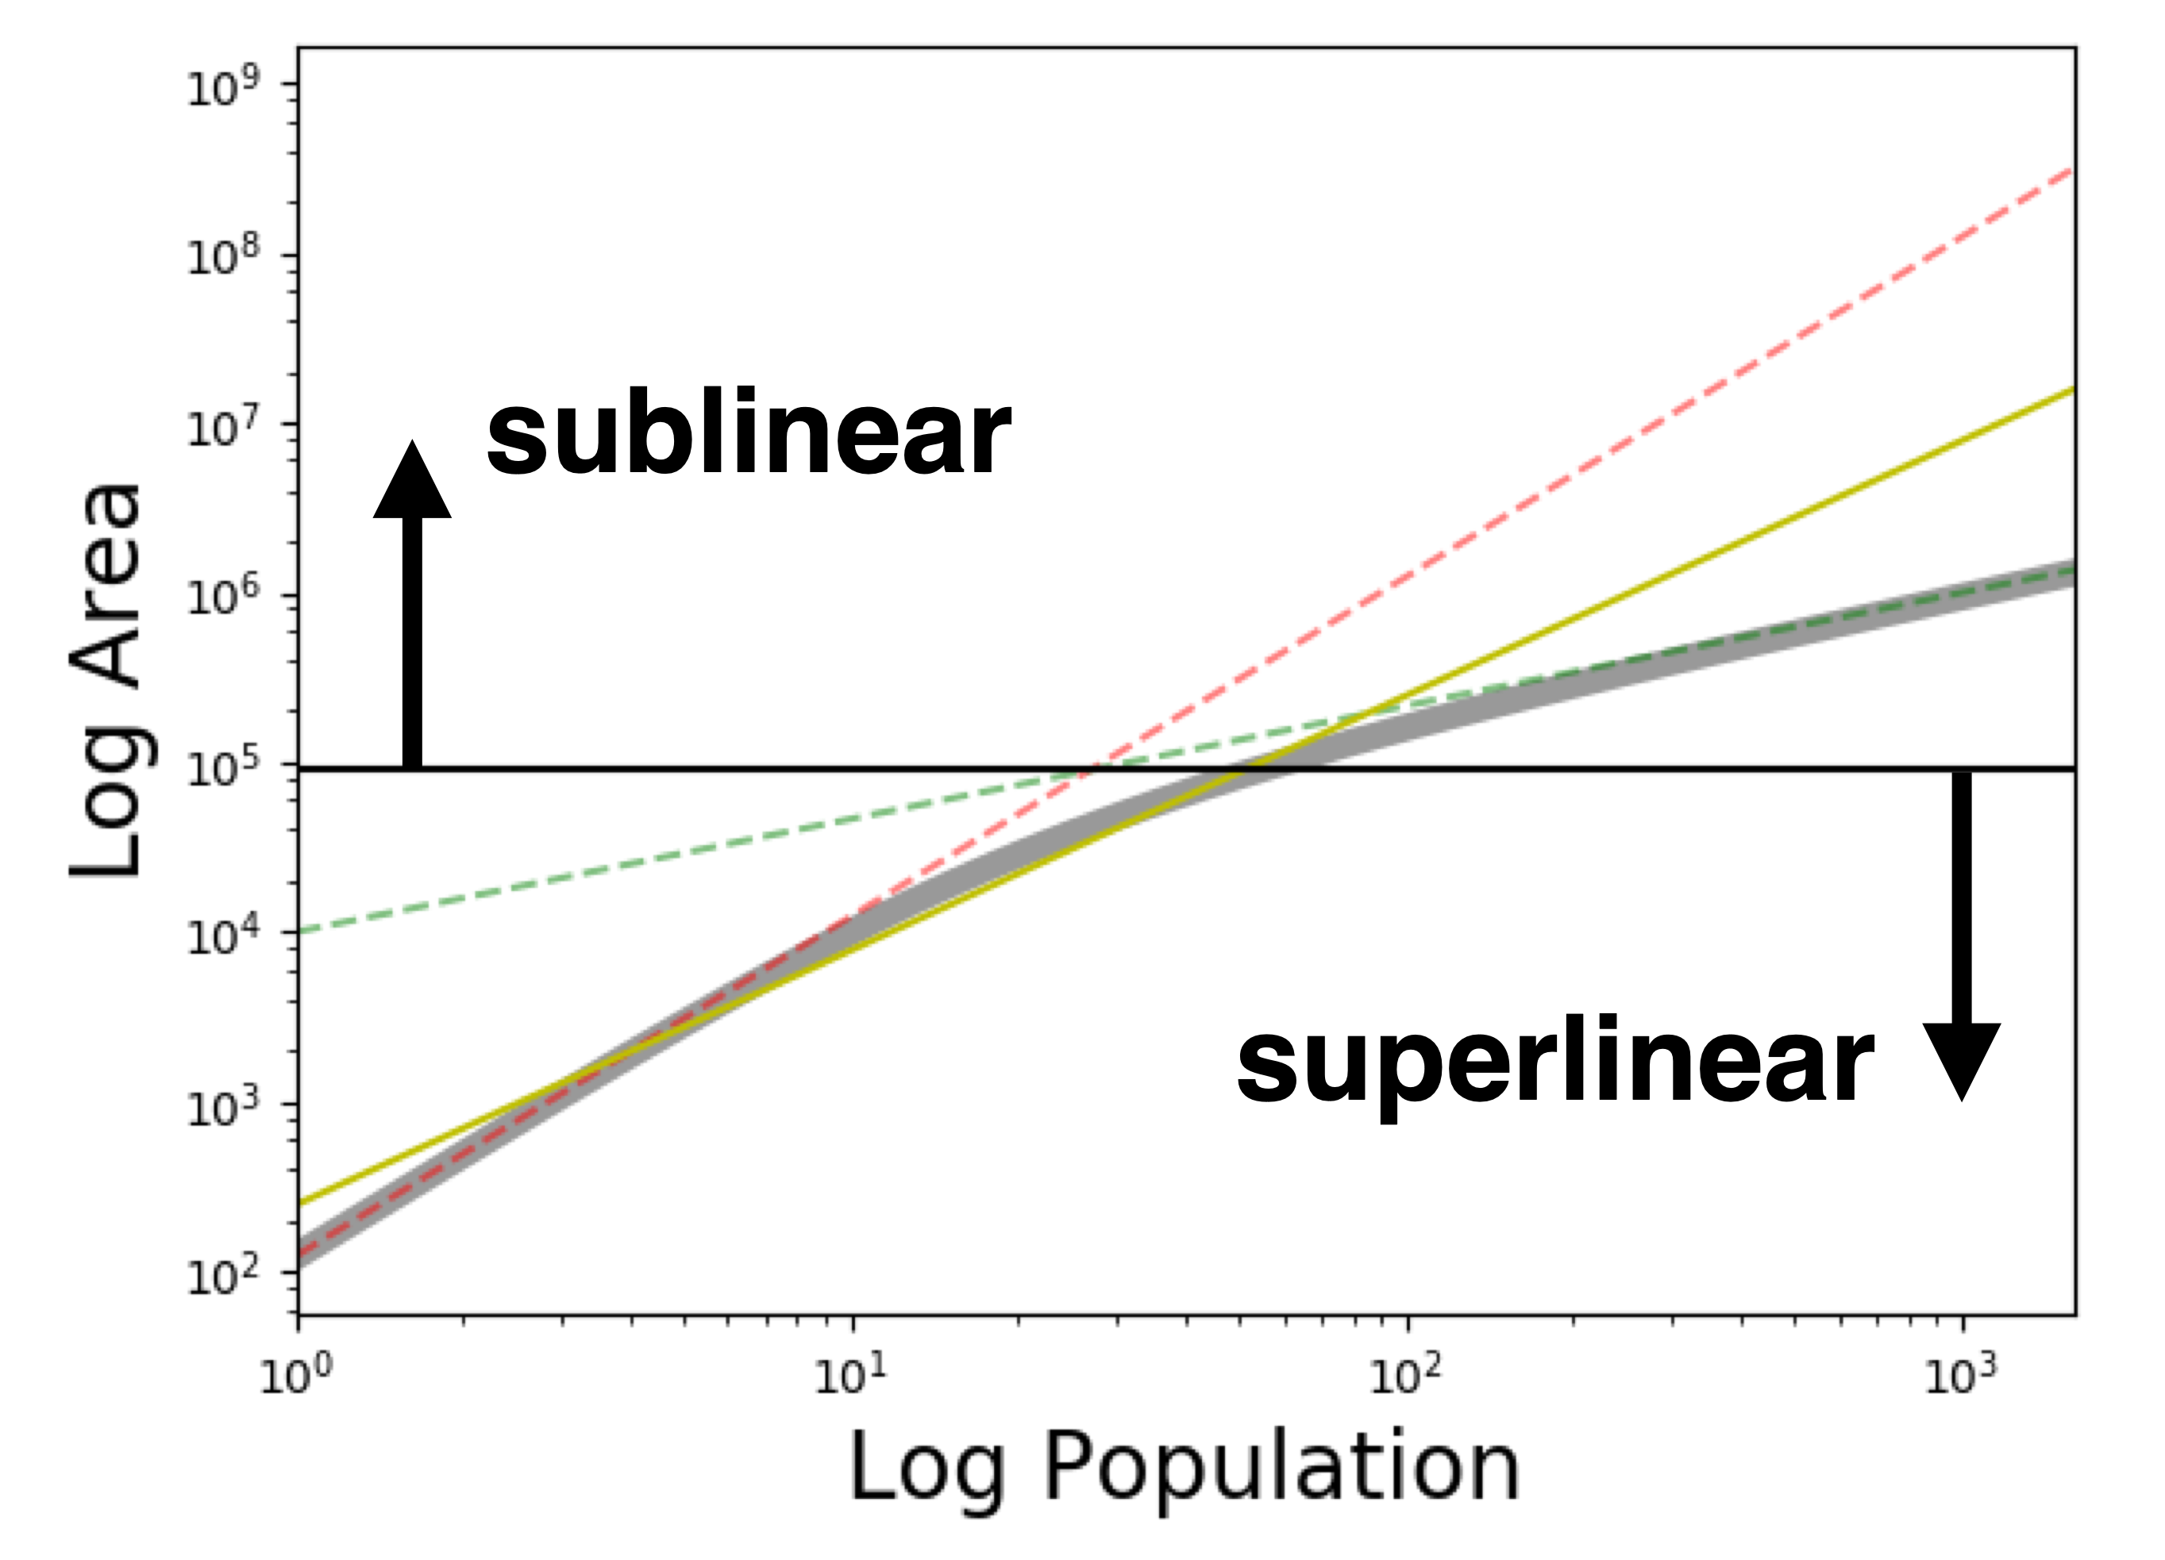
Lobo et al 2018
https://www.journals.uchicago.edu/doi/abs/10.1086/719234
Notes:
Solving the equation numerically looks like this…

Slide 23
A simple model of kinship distance
$$k(N)=k_{0}N^{-γ}$$
Hamilton et al 2007
https://www.pnas.org/content/104/11/4765
average kinship
in a population N
$$γ≃1/f,f=$$
family size
$$f≃4$$
$$ℓ(N)=ℓ_{0}N^{γ}∼1/k(N)$$
distance between extended families
resulting in:
$$A(N)={\left(\frac{G}{ρℓ}\right)}^{2}N^{2}≃{\left(\frac{G}{ρℓ_{0}}\right)}^{2}N^{2-2γ}∼N^{1.5}$$
Approximately right exponent
https://www.journals.uchicago.edu/doi/abs/10.1086/719234
Notes:
Finally, we can venture that the distance between people in camps depends on how closely related they are, but larger populations will be typically less related. This can naturally lead to scaling exponents of order 1.5, assuming that distance is inversely proportional to kinship…

Slide 24
Hunter Gatherer Camps are not like “small cities”: they are qualitatively different
For large human settlements and cities to develop it was necessary:
High density of resource production (food, energy)
Constant conflict resolution (solve “scalar stress”)
Low costs of interaction and transaction
Argument is that:
These are still our problems today
Food Production Technologies & Political, Organizational Innovation were both necessary
farming, irrigation, construction
private “property”, public goods, political structures, conflict resolution
“Urban Package”
~10,000 years ago (500 generations)
Notes:
So, while more work needs to be done, we see that the seeds of cities may exist in all human societies, but that two problems need to me solved : sufficient energy density and low enough costs of socialization from conflict. When both these issues are addressed sufficiently, the prediction is that settlements are created that start looking like cities. Also that culture can more quickly accumulate. There is therefore something really special about cities, in that they must have been accompanied by both technological and social change, creating the urban package we discussed above.

